Slide 1
Upper Golden Hill
Community Information Meeting
Preservation Zone Designation
June 13, 2024
City Council Chambers

Slide 2
Agenda
Existing Preservation Zones
Request for reclassification of R1-7.2 to add Preservation Zone Designation
What is a Preservation Zone Designation and how will it affect my property?
Mills Act Program
Process for Rezoning with Preservation Overlay
Resources
Questions

Slide 3
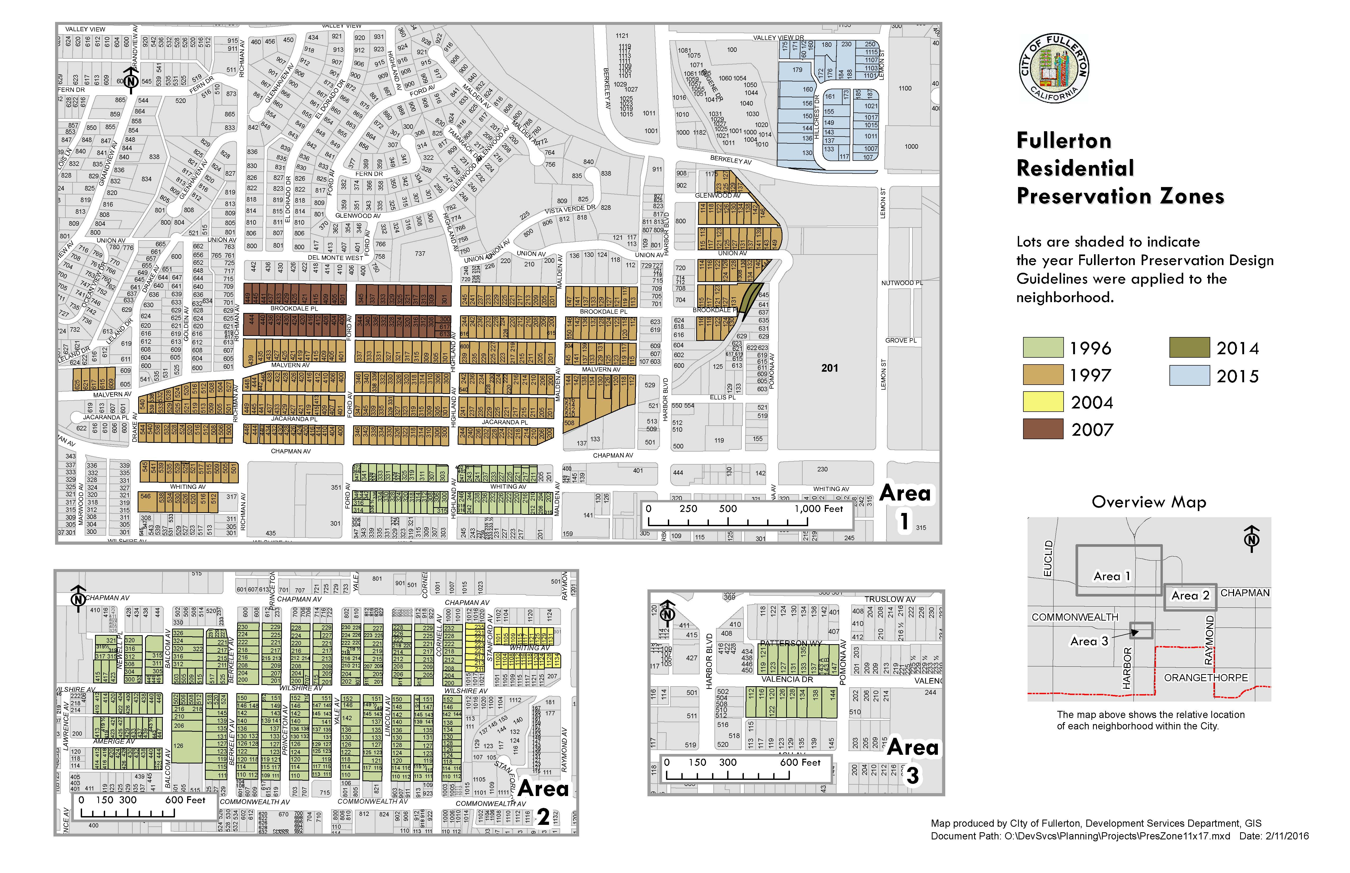
Residential Preservation Zones
Notes:
As background, this a map of existing Preservation Zones in the city. The first Preservation Zone was established in 1996. This map illustrates six neighborhood that have received a Preservation Zone overlay.

Slide 4
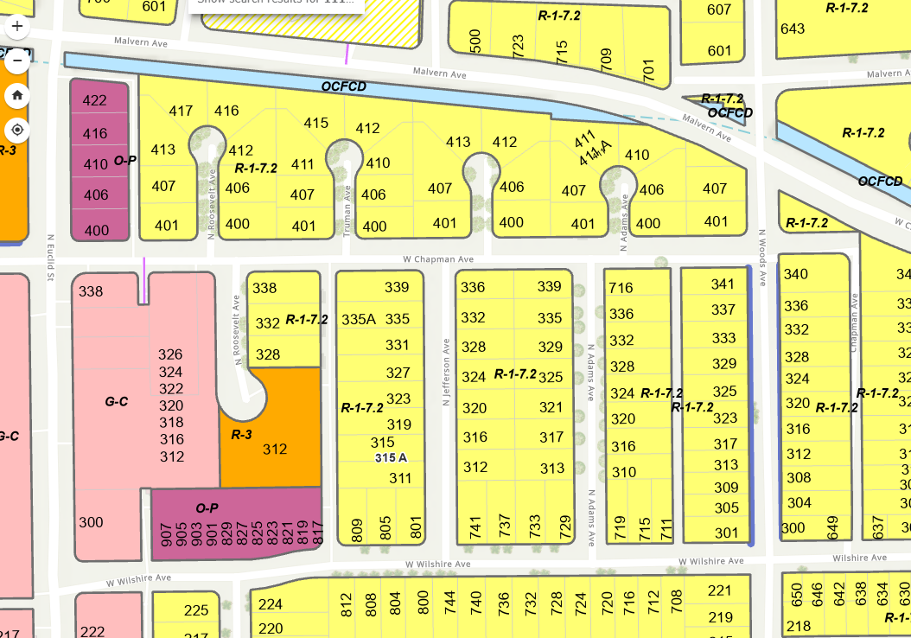
Residential Preservation Zone – Presidents Avenues
N
Notes:
In October, the City Council approved the most recent Preservation Zone that includes the Presidents Avenue neighborhood, illustrated on this map and generally described as the properties on Adams Avenue, Jefferson Avenue, Truman Avenue and Roosevelt Avenue.
In April, a community meeting was held for another Potential Historic District, considered the West Wilshire, Woods, and Wickett Square District, east of the Presidents Avenue neighborhood. A petition is currently circulating to gain property owner interest in pursuing a Preservation Zone

Slide 5
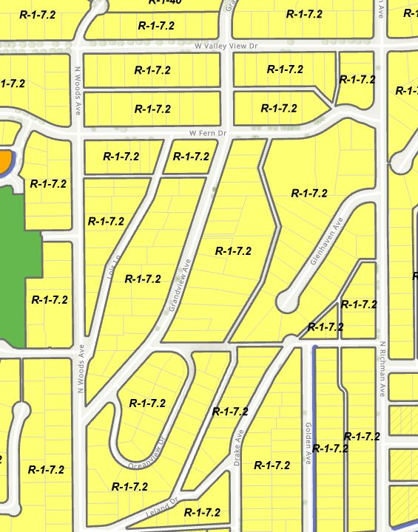
Preservation Zone Community Meeting
Upper Golden Hill
N
Notes:
Recently, City staff received a petition by property owners interested in information regarding a Preservation Zone for the Upper Golden Hill neighborhood outlined and shaded on this map.
The proposed Preservation Zone includes the properties located on…
South side of West Valley View Drive, from 512 through 636 West Valley View Drive.
Both sides of Fern Drive, from 510 through 639 Fern Drive.
East side of North Woods Avenue, from 817 through 856 North Woods Avenue.
Both sides of Lois Lane, from 658 through 857 Lois Lane.
711 Grandview Avenue and both sides of street, from 800 through 865 Grandview Avenue.
West side of North Richman Avenue from 833 through 915 North Richman Avenue.
Properties within the proposed preservation zone are currently zoned R-1-7.2, One Family Residential. Indicated with a green star are the location of designated Local Landmarks or Significant Properties.

Slide 6
Residential Preservation Zone
FMC Chapter 15.48 – Landmarks, Landmark Districts, Residential Preservation Zones and Significant Properties
Establishes guidelines for preservation, restoration and protection of historic and cultural resources
What is a Residential Preservation Zone?
How does a Residential Preservation Zone affect my property?
Allows for new development and additions, including Accessory Dwelling Unit
Construction must be in keeping with traditional character of the area
Subject to Design Guidelines and review
Does not allow for two-unit housing development, “Urban Lot Split” (FMC 15.17.130)
Establishes procedure for review of requests for residential preservation zone designation
Notes:
Fullerton Municipal Code Chapter 15.48 deals with matters related to historic properties and districts for the purpose of recognizing that it is desirable to preserve, restore and protect historic and cultural resources in the City. It establishes the need for guidelines in order for the city to work with the public to preserve those elements of Fullerton’s heritage into the future.
There are multiple historic designations, but a Residential Preservation zone is a type of zone classification that is applied to a mature residential neighborhood where the existing housing and environment has been determined to be a valuable asset to the City and should be preserved. This type of zone allows new development and additions to existing housing, including Accessory Dwelling Units, but construction must be in keeping with the traditional character of the area. A preservation zone is also subject to design guidelines that have been adopted by City Council.
The Fullerton Municipal Code (Section 15.17.130) incudes recent State Law that provides for R-1 zoned property to be eligible for Two-unit housing development, referred to as an Urban Lot Split. This provision potentially allows for the subdivision of a parcel into two parcels with lots of at least 1,200 square feet. Each parcel could consist of two new units or one new unit and one existing unit. Such a subdivision is an administrative, staff review, process. A Preservation Zone is considered an historic district and would not allow for a two-unit housing development or Urban Lot Split.
Fullerton Municipal Code Chapter 15.48 also provides the process and procedure the City and a neighborhood interested in a preservation overlay will take to obtain a zone change. In this case, the existing zone would retain the R-1 zone, but a P would be added to the zone designation to indicate that the properties are located within a preservation zone.

Slide 7
FMC Chapter 15.17 RESIDENTIAL ZONE CLASSIFICATIONS
15.17.050 Site development standards (R-1, R-1P, R-2, R and R-2P zone classifications
Building setbacks (front yard 15-25 feet)
Garage parking
Maximum floor area – 50 percent of lot size
15.17.060 Additional Development Standards for preservation zones
20-foot front yard setback encouraged
Half of required parking may be carport, paved space
New driveway for open parking space discouraged (Director approval)
Floor area limited to 40 percent of lot area where a dwelling unit is preserved and limited to 35 percent of lot area where no existing dwelling units are preserved.
Notes:
Fullerton Municipal Code Chapter 15.17 pertains to residential zones and identifies development standards for the R-1 and R-1P zones. The development standards include building setbacks, open space, lot coverage limit, garage parking and a maximum floor area limited to 50 percent of the lot size.
The Municipal Code also identifies additional development standards for preservation zones. These include all buildings are encouraged to have a minimum front yard setback of 20 feet, half of required parking may be in the form of a carport or open, paved space, located behind the front yard setback. A new driveway for the purpose of providing an open parking space will be discouraged and subject to approval of the Director of Community and Economic Development. The total gross floor area of all dwelling units on the property shall not exceed 40 percent of the net lot area of any property on which at least one existing dwelling unit is preserved and shall not exceed 35 percent of the net lot area where no existing dwelling units are preserved.

Slide 8
City Review for residential preservation zone projects
(R-1P, R-2P and R-3P).
15.17.060.A. Project to comply with the Design Guidelines for Residential Preservation Zones
15.17.060.B. All proposed development is subject to review, except repainting and exterior repair.
15.17.060.B.1 Director Review: Minor Alterations
15.17.060.B.2 Site Plan Review: Additional dwelling (ADU), additions more than 50 percent of existing floor area, additions more than 500 square feet, or addition readily visible from public street.
15.17.060.B.3 Site Plan Review and Landmarks Commission: Demolition or Partial Demolition
Notes:
This slide identifies the city review for projects located in residential preservation zones.
A project needs to comply with adopted Design Guidelines for residential preservation zones. The primary objective of the Design Guidelines is to retain and preserve features of the building site that are important to the overall historic character of the neighborhood. As an underlying policy, original architectural elements of existing residences should be retained, repaired or restored rather than replaced. Additions need to be compatible with the existing development in terms of massing, size, scale and architectural features.
All proposed development is subject to review except repainting and exterior repair.
Community Development Director review is required for minor alterations including the addition, change, or removal of exterior architectural features and existing hardscape. Minor improvements include air conditioning units, roof mounted equipment, arbors, trellises and fences. The Director may also review development where structures are enlarged by less than 50 percent of the existing floor area, or the addition is less than 500 square feet and is not readily visible from the public street.
A Site Plan Review application is required for additional dwelling units, additions that are more than 50 percent of existing floor area, or more than 500 square feet or the addition is readily visible from street. A Site Plan Review application requires the submittal of a City application, plans and fee ($2,661).
A Site Plan Review application and Landmarks Commission review is required for the demolition of a residential structure in a preservation zone wherein more than 50% of the structure will be removed from a site either by relocation or destruction, or when any portion of the street facing elevation is demolished.

Slide 9
FMC Chapter 15.17.060.D Decision to Approve/Deny
15.17.060.D. Decision to Approve or Deny a Request based on four (4) objectives.
1. Preservation and rehabilitation of existing affordable housing and neighborhood lifestyle. Additionally, the intent is to protect and enhance the historic character of development found within the preservation zones.
2. If existing housing is clearly deteriorated or dilapidated beyond rehabilitation, or if a residential structure does not contribute to, or is not compatible with, the established character of the neighborhood, said housing may be removed.
3. Where proposed new construction is found to be incompatible by reason of obtrusiveness, excessive bulk, over development, inappropriate architectural style or nonresidential character, the proposal shall be modified or denied.
4. Objectives of Design Guidelines for Residential Preservation Zones
Notes:
The decision to approve or deny a requested development in a residential preservation zone is based on the following four objectives.

Slide 10
Mills Act Program
Allows the city to enter into a contract with a property owner to restore, rehabilitate and/or maintain a historic property in exchange for property tax savings
Must meet the definition of “qualified historical property”, including located within a registered historic district (i.e. Preservation Zone)
Mills Act Program Guidelines include:
Rehabilitation/Maintenance Plan to ensure Mills Act properties are well maintained and property tax savings are reinvested in the property.
No maximum assessed property valuation.
Allows previous work to be counted towards work plan.
$1,000 fee to recover City’s cost to administer program.
Notes:
The City has adopted the Mills Act Program which allows…

Slide 11
15.48.055. Procedure for Review of Requests for a
Residential Preservation Zone Designation.
1. Upon receiving a letter from one or more property owners in a neighborhood requesting an interest in having the neighborhood reclassified to a residential preservation zone, the Director of Community and Economic Development shall organize one or more informational meetings.
2. The informational meetings shall be structured to explain the preservation zone rules and the public hearing process for its implementation. The Community and Economic Development Department may jointly sponsor these meetings with a local preservation group, which may assist in explaining the intent of the residential preservation zone to the neighborhood.
3. After one or more informational meetings are held, a formal petition may be circulated by interested property owners of that neighborhood to solicit support for a particular residential preservation zone.
4. If at least 51 percent of the property owners of the defined neighborhood sign the petition, the Community and Economic Development Department shall initiate a zone amendment to consider the request to reclassify the defined neighborhood to the particular residential preservation zone.
Notes:
The Municipal Code identifies the following procedure for review of requests for a residential preservation zone designation.

Slide 12
Documents
The Fullerton Plan Historical Preservation Element
Master Plan of goal and policies for historic preservation
Local Register of Historical Resources
https://www.cityoffullerton.com/government/departments/community-and-economic-development/planning-zoning/historic-resources
City of Fullerton Municipal Code (Chapters 15.48 & 15.17)
https://codelibrary.amlegal.com/codes/fullerton/latest/fullerton_ca/0-0-0-1
City of Fullerton Design Guidelines for Residential Preservation Zones
https://www.cityoffullerton.com/government/departments/community-and-economic-development/planning-zoning/zoning
City of Fullerton Mills Act Program Guidelines
https://www.cityoffullerton.com/government/departments/community-and-economic-development/planning-zoning/historic-resources
Notes:
The following are available documents from the City’s web page related to a Preservation Zone designation.

Slide 13
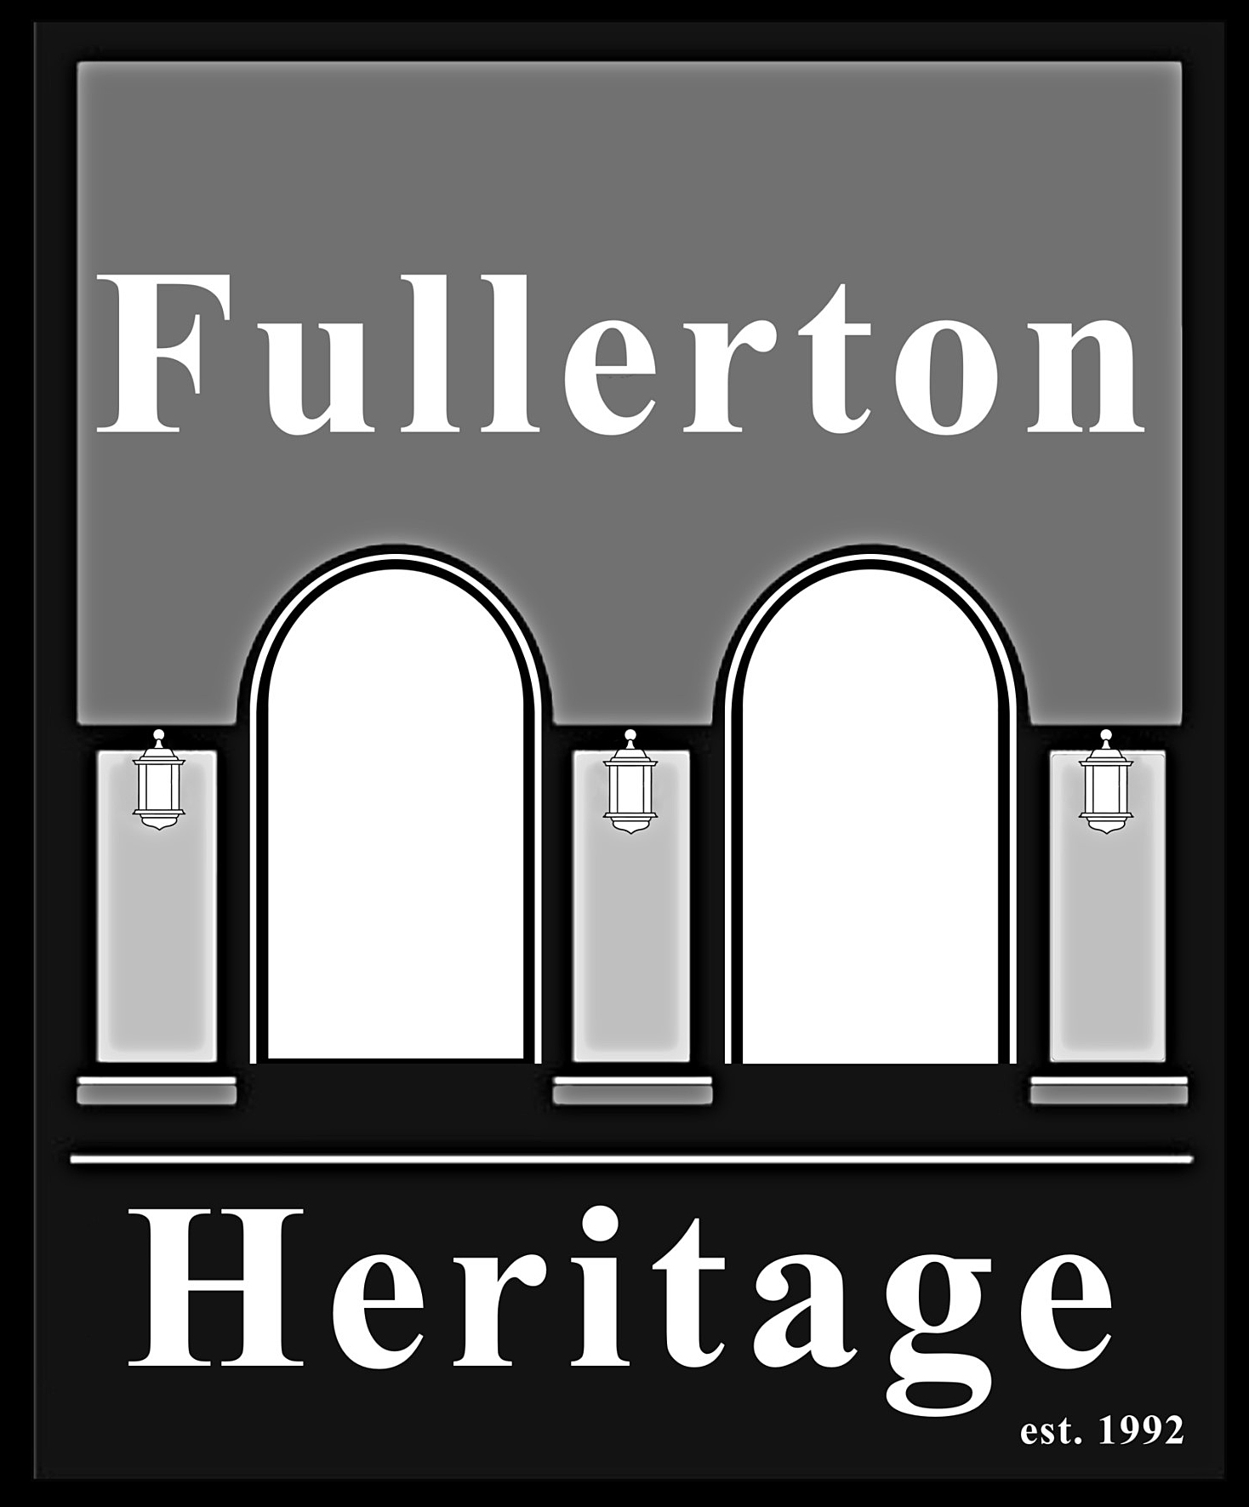
CONTACT INFORMATION:
Andrew Kusch, Associate Planner
Community & Economic Development (714) 738-6550
Andrew.Kusch@cityoffullerton.com
Fullerton Heritage
(714) 740-3051
https://fullertonheritage.org
Notes:
Here is my contact information. It also has been provided in the public notice that was mailed for this meeting,
We have with us this evening members of Fullerton Heritage, a non-profit, organization that has been at the forefront of advocating for historic preservation in Fullerton. The organization provides a wealth of Fullerton historic knowledge, including extensive research and volunteer hours in establishing Preservation Zones, and designating individual properties on the National Register of Historic Places or as Local Landmarks. I would add that the Fullerton Library has a historic archive of Fullerton which, in part, is accessible from the City’s web page. I would invite anyone from Fullerton Heritage if they would like to provide any additional information or insight regarding Fullerton Preservation, including the proposed Preservation Zone.

Slide 14
Questions?

Slide 15
Upper Golden Hill
Community Information Meeting
Preservation Zone Designation
June 13, 2024
City Council Chambers

